Slide 1
DI & Decoupling
C++ Unit Testing

Slide 2

EXERCISE
为了更好的服务读者, 图书馆引进了图书查询(SearchEngine)和推荐系统(RecommendEngine):
管理员会使用查询和推荐系统根据读者提供的关键字推荐一本书
查询系统会查询并返回所有包含指定关键字的书籍
推荐系统会选择并返回查询结果中最流行的一本书
Notes:
介绍新需求

Slide 3
EXERCISE
从原始Repo上更新代码
git remote add source http://github/DT.git
git pull source master
打开工程03-Decoupling.sln,编译并运行
阅读代码, 了解查询系统和推荐系统原理及管理员对查询推荐系统的使用方式
修改推荐系统(RecommendEngine)的推荐算法, 选择最便宜的书进行推荐(TDD)
Notes:
修改推荐算法时修改了几个测试
为什么要修改Librarian的测试, 管理员的操作流程应该受到推荐系统工作方式影响吗?
怎么办?

Slide 4
Dependency Injection
Testable Design

Slide 5
Dependency Injection
Injection
Dependency

Slide 6
Advantages
Dependency Injection decreases coupling between a class and its dependency.
Dependency injection allows a client to remove all knowledge of a concrete implementation that it needs to use.
Dependency injection can be used to externalize a system's configuration details into configuration files.
Dependency injection allows concurrent or independent development.
Easier to unit test in isolation using stubs or mock objects that simulate the dependent objects.

Slide 7
EXERCISE
重构代码, 将RecommendEngine通过构造函数注入到Librarian中
使用RecommendEngineMock完善Librarian::recommend()的测试
修改推荐算法, 选择书名最长的书籍进行推荐
思考: 能否对查询引擎(SearchEngine)进行依赖注入
Notes:
修改推荐算法时修改了几个测试
为什么要修改Librarian的测试, 管理员的操作流程应该受到推荐系统工作方式影响吗?
怎么办?

Slide 8
Decoupling
Interface Oriented Design

Slide 9
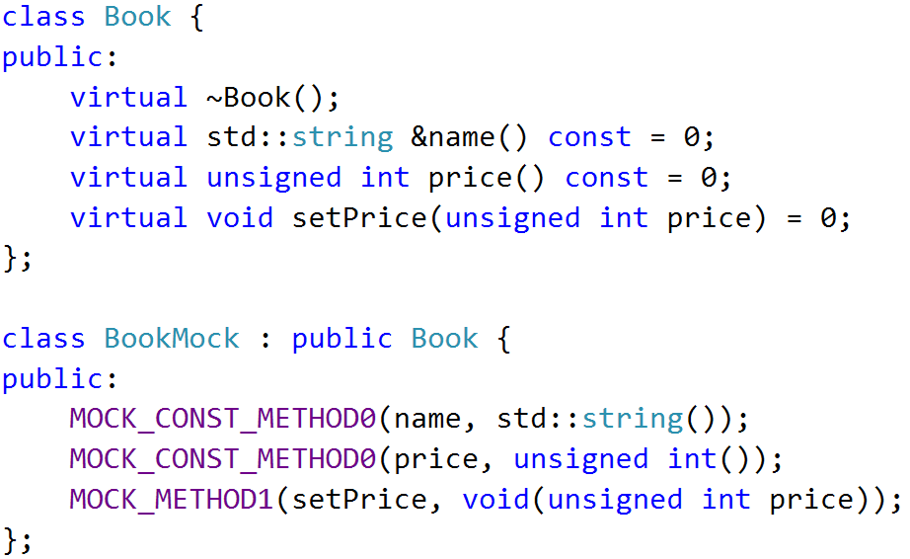
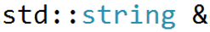
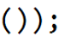
MOCK Object
A mock object implements the same interface as a real object (so it can be used as one), but lets you specify at run time how it will be used and what it should do

Slide 10
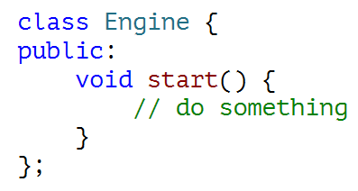
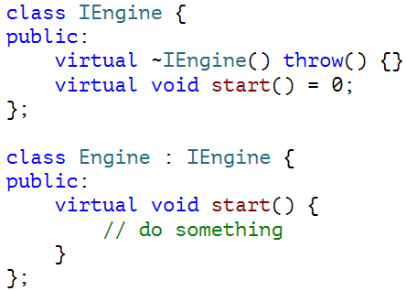
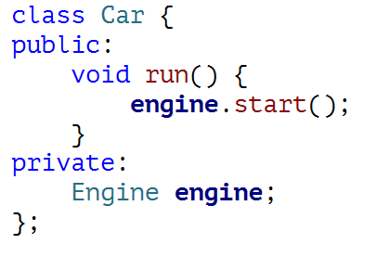
Extract Interface
Non-Virutal
Virutal Function

Slide 11
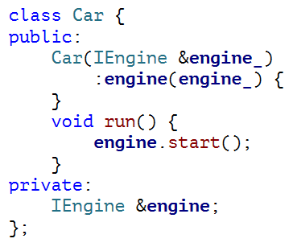
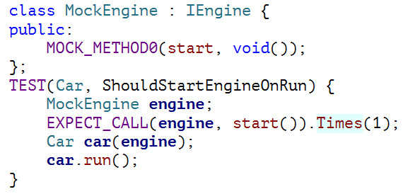
MOCK Interface

Slide 12
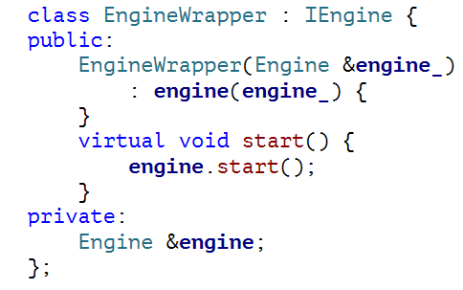
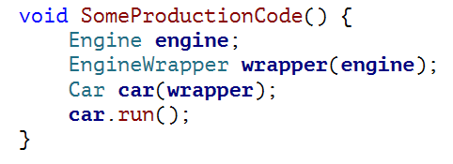
Interface Wrapper

Slide 13
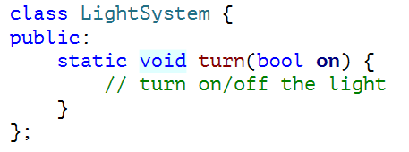
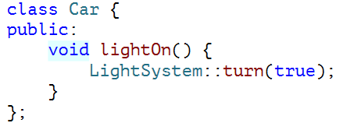
Wrap Static Function

Slide 14
EXERCISE
重构代码, 将 SearchEngine 通过构造函数注入到Librarian中
Mock SearchEngine::Search, 完善Librarian::recommend()的单元测试
使用真实的SearchEngine和RecommendEngine编写Librarian::recommend()的集成测试

Slide 15
Reference
Inversion of Control Containers and the Dependency Injection pattern
http://www.martinfowler.com/articles/injection.html
深度理解依赖注入
http://www.cnblogs.com/xingyukun/archive/2007/10/20/931331.html

Slide 16
THANK YOU
For questions or suggestions:
Wu Kun
kunwu@thoughtworks.com

